Slide 1
Welcome and Introduction
Year 2 Curriculum Assessments

Slide 2
Welcome
Teacher Assessments
End of KS1 ‘tests’
Things you can do at home
Questions

Slide 3
Teachers’ knowledge of the child
Children’s work
Teachers’ knowledge of the Development Stage of each piece of work
Observations of what children say, do and think
Teachers’ understanding of the rate at which children learn
Termly ‘testing’ in Reading, Writing & Maths

Slide 4
End of KS1 Expectations
Working at Greater Depth
Working at the Expected Standard
Working towards the Expected Standard
Working at a Foundation Stage

Slide 5
In May children will complete assessments:
Two maths papers
Two reading papers
These were formerly known as ‘SATs’
Do not worry.

Slide 6
Maths
Paper 1: Arithmetic
Addition
Subtraction
Multiplication
Division
Fractions
Counting in 2s, 3s, 5s, 10s
Have a strategy for addition & subtraction
Number bonds for 10
Adding 10 to any number
Sample paper

Slide 7
Maths
Paper 2: Reasoning
Here’s a link on our website

Slide 8
Reading
Things to think about when your child is reading.
Do I tell them or help them to sound it out?
Are there some sounds they don’t know?
Using the pictures to help
Are they self correcting
Not finger pointing
Can they read fluently?

Slide 9
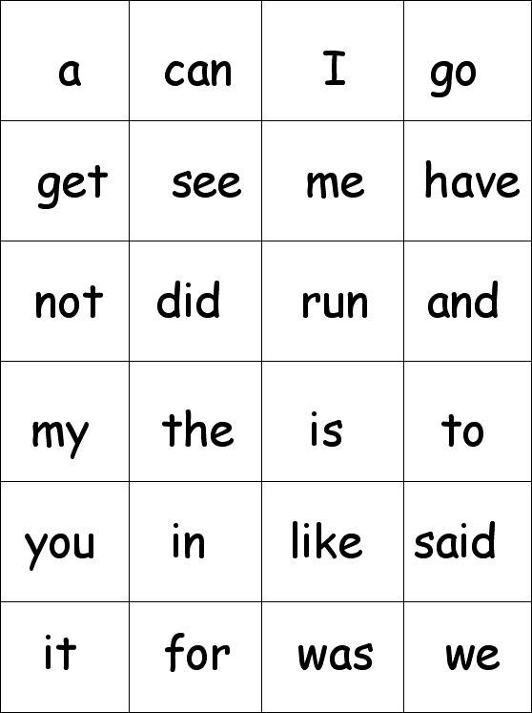
Sight Words

Slide 10
Comprehension
What does the girl like to do?
What does her brother do to scare her?

Slide 11
Inference – Reading Between the Lines
What does ‘slept soundly’ mean?
Do you think they get on with each other?

Slide 12
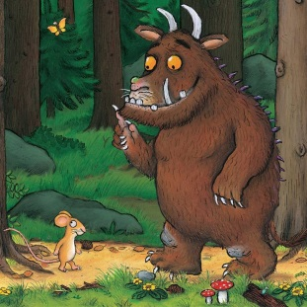
Reading at Greater Depth

Slide 13
Words for then | Adjectives | Adverbs | Connectives
Afterwards, Meanwhile, Suddenly, Later on, Next day, At first, Next, All of a sudden, Finally, | ugly large grumpy scruffy mighty mean brave clever long wavy | quickly carefully angrily happily joyfully slowly politely softly helpfully nervously playfully | because as since so but when however
Jack climbed the Beanstalk.
Afterwards, Jack, who was brave, climbed the long, wavy beanstalk carefully, as he wanted to see what was at the top.

Slide 14
Handwriting

Slide 15
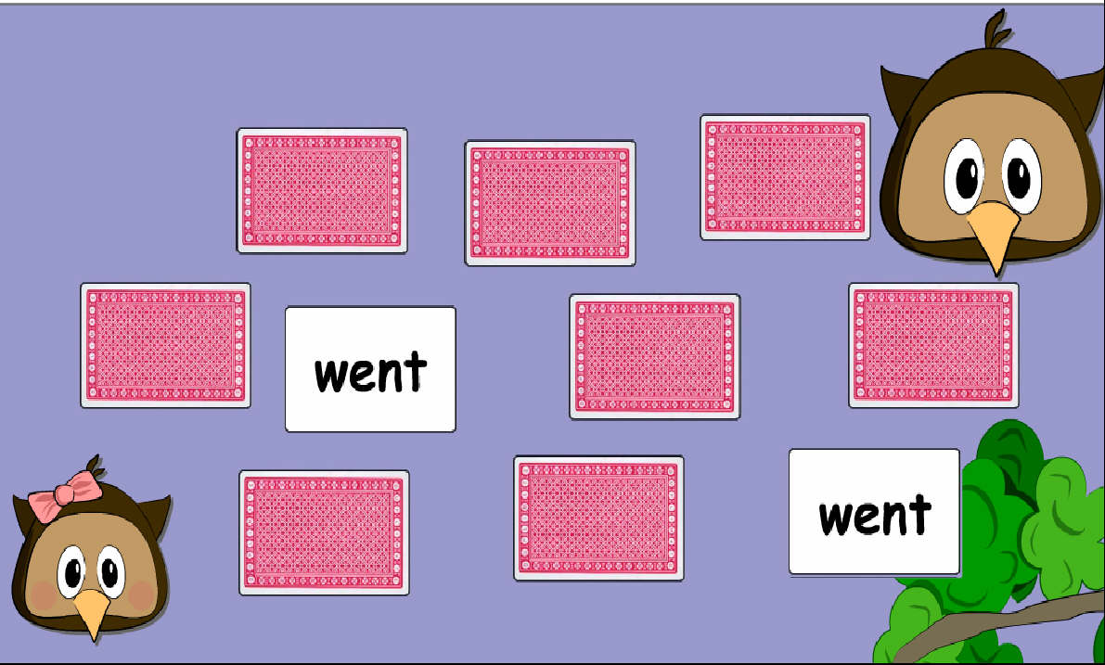
What can we do at home?

Slide 16
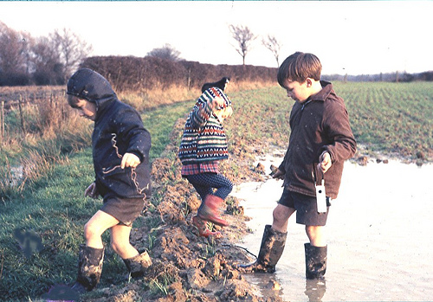
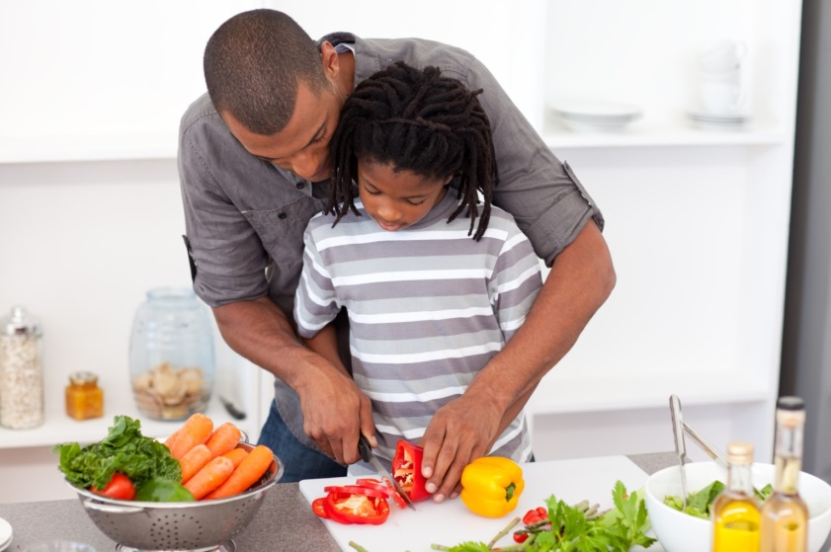

Slide 17
Before you go. . .
Please help us by filling out a feedback form
Take some helpful sheets with you
Talk to us – we’re here if you have any questions

